Slide 1

ACADEMIC ADVISING SESSION
Spring 2013

Slide 2
2nd semester mandatory advising
FRESHMEN ONLY
  All 2nd semester freshmen are required to complete this requirement before being able to register for Fall 2013 courses
  If you are listed as an Undeclared student, this session will satisfy your 2nd semester mandatory advising requirement.
  If you are declared as any of the following majors, you must go to see your major advisor to clear this requirement
      Engineering
      Music
      Liberal Studies
      Pre-business
      Pre-nursing
      SmittCamp Honors
      Student Athletes

Slide 3
Agenda
I. General Education Review
II. GE Quiz
III. Semester Academic Plan

Slide 4

Purpose of GE
Developing and Strengthening Basic Skills
Success in your Major
Success in your Career
Notes:
Paragraph 2

Slide 5
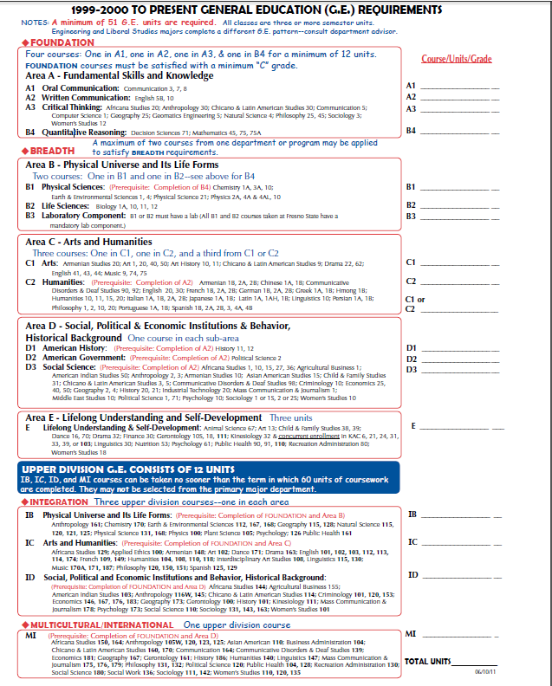
GE Pattern
Four Categories
Lower Division
-Foundation
-Breadth
(Numbered 1-99)
Upper Division
- Integration
-Multicultural/
International
(Numbered 100-199)
Notes:
Paragraphs 3 and 4 and 5

Slide 6

Lower Division GE - FOUNDATION
FOUNDATION- 12 Units
Area A- Fundamental Skills and Knowledge
  A1- Oral Communication
  A2- Written Communication
  A3- Critical Thinking
  B4- Quantitative Reasoning
**Must be completed with a “C” grade or higher
Notes:
Paragraph 6 (Foundation)

Slide 7
Lower Division GE - BREADTH
BREADTH- 27 Units
Area B- Physical Universe and It’s Life Forms
Area C- Arts and Humanities
Area D- Social, Political & Economic Institutions & Behavior
Area E- Lifelong Understanding and Self-Development
Notes:
Paragraph 7(Breadth)

Slide 8

Lower Division GE - BREADTH
BREADTH
Area B- Physical Universe and It’s Life Forms
    B1- Physical Sciences
    B2- Life Sciences
    B3- Laboratory Component
Notes:
Paragraph 7(Breadth)

Slide 9
Lower Division GE - BREADTH
BREADTH
Area C- Arts and
Humanities
    C1- Arts
    C2-Humanities
    C1/C2- Arts or Humanities
Notes:
Paragraph 7(Breadth)

Slide 10
Lower Division GE - BREADTH
BREADTH
Area D- Social, Political & Economic Institutions & Behavior
    D1- American History
    D2- American Government
    D3- Social Science
Notes:
Paragraph 7(Breadth)

Slide 11
Lower Division GE - BREADTH
BREADTH
Area E- Lifelong
Understanding and
Self-Development
Notes:
Paragraph 7(Breadth)

Slide 12
Upper Division GE - INTEGRATION
INTEGRATION- 9 units
Area IB- Physical Universe and It’s Life Forms
Area IC- Arts and Humanities
Area ID- Social, Political and Economic Institutions and Behavior, Historical Background
Notes:
Paragraph 8

Slide 13
Upper Division GE - INTEGRATION
MULTICULTURAL /
INTERNATIONAL- 3 units
Area M/I
Notes:
Paragraph 8

Slide 14
Upper Division GE
Upper Division courses may not be selected from your primary major.
You must also have completed or be approaching 60 units before enrolling in Upper Division courses
Notes:
Paragraph 7(Breadth)

Slide 15
General Education
Review
Lower Division – Five Areas
(Areas A, B, C, D & E) (39 Units)
Upper Division – Four Areas
(Areas IB, IC, ID & MI) (12 Units)
Total of 51 Units (Minimum)
** only one course in each area

Slide 16

Pre-requisites
What is a Pre-requisite?
Pre-requisite
Notes:
Paragraph 10

Slide 17
Pre-requisites
Lower Division
  Area B1- Completion of Area B4
  Areas C2, D1, D2 & D3- Completion of Area A2
Upper Division
  Area IB- Completion of Foundation & Area B
  Area IC- Completion of Foundation and Area C
  Areas ID & MI- Completion of Foundation and Area D
Notes:
Paragraph 11

Slide 18
Academic Standing
Student Level | Units Earned or Completed | Good Standing (Campus and Cumulative GPA) | Probation (Campus or Cumulative GPA) | Disqualification (Campus or Cumulative GPA)
Freshman | 1 – 29 units | 2.00 or above | 1.99 to 1.50 GPA | 1.49 GPA or below
Sophomore | 30 – 59 units | 2.00 or above | 1.99 to 1.70 GPA | 1.69 GPA or below
Junior | 60 – 89 units | 2.00 or above | 1.99 to 1.85 GPA | 1.84 GPA or below
Senior | 90+ units | 2.00 or above | 1.99 to 1.95 GPA | 1.94 GPA or below
Post Baccalaureate | 0+ units | 2.00 or above | 1.99 to 1.95 GPA | 1.94 GPA or below
Graduate | 0+ units | 3.00 or above | 2.99 to 2.00 GPA | 1.99 GPA or below

Slide 19
Quiz Time!

Slide 20
Question #1
Lower division courses are numbered between
  A) 0-60
  B) 100-199
  C) 1-99
  D None of the above

Slide 21
Question #2
Foundation courses must be completed with a “C” grade or higher
  A) True
  B) False

Slide 22
Question #3
A specific course that is required to be completed before enrolling in another course is called
  A) Lower division course
  B) Upper division course
  C) Major course
  D) Pre-requisite

Slide 23
Question #4
Upper division courses may not be taken sooner than the term in which 60 units are completed
  A) True
  B) False

Slide 24
Question #5
The General Education courses consist of a minimum of how many units?
  A) 30 units
  B) 61 units
  C) 51 units
  D) 75 units

Slide 25
Question #6
Which of the following is not part of the General Education categories
  A) Breath
  B) Integration
  C) Multicultural/International
  D) Exploration

Slide 26
Question #7
To maintain a good academic standing, a student must have a gpa above
  A) 2.50
  B) 2.00
  C) 1.80
  D) None of the above

Slide 27
Group Share
In your groups, discuss what you feel will be your top 3 challenges next semester. Share strategies to address these challenges.

Slide 28
Things to Consider When Planning your classes
Balancing
Time management
Family roles and responsibilities
Culture

Slide 29
Struggling In Class
Utilize Resources
COMPUTER
LABS
WRITING
CENTER
LIBRARY
TUTORS

Slide 30
See Your EOP Counselor and Peer Mentor schedule your appointments now
Call 278-1787

Slide 31
Mark your progress!
Fill in the GE courses that you have successfully completed.

Slide 32
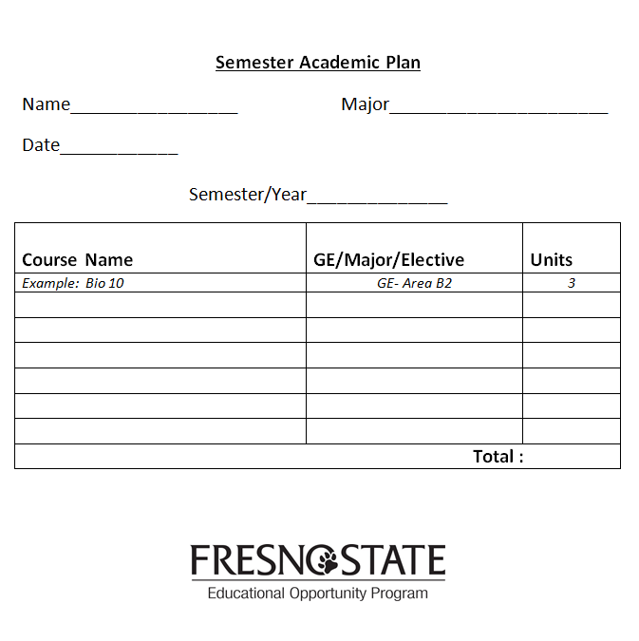
Semester Academic Plan
Fill out the semester academic plan to include courses that you plan to take next semester

