Slide 1

Fall 2016
Admissions Updates
Admissions & Records

Slide 2
Updates since Fall 2015 admissions cycle
Impaction
Beginning with the fall 2016 admission cycle, Fresno State is program and university impacted
SB 1440
.1 gpa bump instead of .2 for SB 1440 students (beginning with fall 2016)
Verification can be done online at https://adtverify.calstate.edu/adtu/faces/Welcome.jsf
Accept/Decline and Mandatory Dog Days Orientation
Final Unofficial Grade Form
AP scores no longer prevent a student’s file from becoming complete. If AP scores are needed for admission, they still need to be submitted by February 15, 2016

Slide 3
Spring 2016 admissions
August 1-31st – Application filing period – received close to 1,000 applications
September 15th – Document deadline – FIRM deadline
October 1- November 30th – Accept/Decline
October 31st – ADT Verifications Due
Preferred method = ADT eVerify website
Will accept hard copy form from community colleges (mail, fax, etc.)
November – Transfer evaluations for admitted students who accepted their admission and registered for Dog Days
December 3 and 4 – Mandatory Dog Days sessions (choose one)
Late December & Early January – update records with AA-T/AS-T degrees in Education Panel and appropriate code in u.achieve
January 29th – Deadline to receive official transcripts with AA-T/AS-T posted

Slide 4
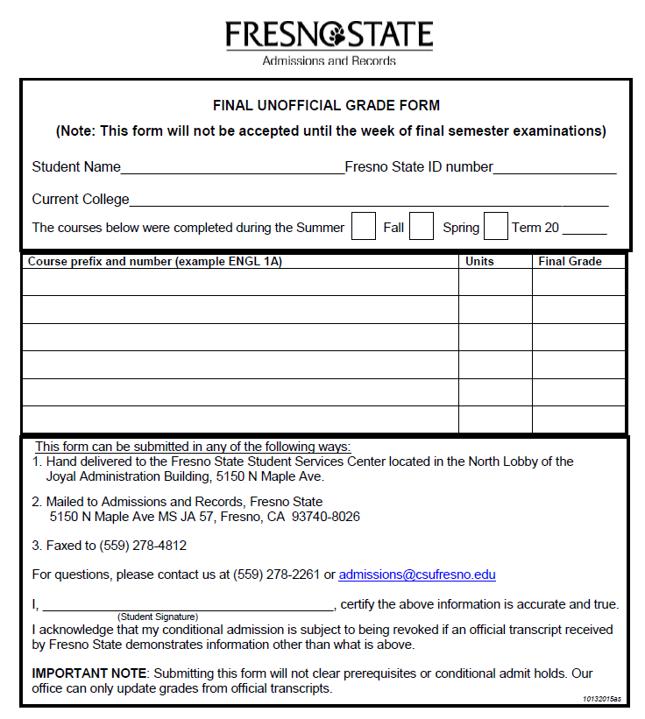
Final Unofficial Grade Form (used for spring admissions)
Form can be found at http://www.fresnostate.edu/studentaffairs/are/forms/index.html

Slide 5
Transfer Admission Requirements Fall 2016
Minimum Requirements
Local vs Non-local
60 transferable units
30 units completed in CSU GE
‘C’ or better in the following:
A.1 – Oral Communication
A.2 – English Composition
A.3 – Critical Thinking
B.4 – Quantitative Reasoning
2.2 GPA or higher in all transferable units attempted
Good standing at last institution
Transfer applicants with majority of units outside the local service area will be considered on a space available basis if they have a minimum 2.70 GPA or higher in all transfer work and meet minimum admission requirements
Local area colleges
Clovis Community College
College of the Sequoias
Fresno City College
Merced College
Modesto Junior College
Reedley College
West Hills College

Slide 6
What we look for in Golden 4 courses
A1 – Oral Communication
3 speeches
No combination courses (includes interpersonal)
No professional communication courses
A2 – Written Communication
Research component, at least 3 formal papers
Meets lower division writing requirement for regionally accredited university
Critical reading, writing as a process (multiple drafts), expository
A3 – Critical Thinking
Reason, analyze, fallacies, factual conclusions
Understand logic, inductive/deductive processes, formal/informal arguments
B4 – Quantitative Reasoning
STATED prerequisite of intermediate algebra or 2 years of high school algebra, not 2 years of high school math

Slide 7
Transfer Admissions Process
APPLY OCT 1- NOV 30
Submit application on www.csumentor.edu during the application period of October 1-November 30
Students will receive a Letter of Acknowledgement via email and hard copy within days of Fresno State receiving their application. The letter includes instructions on how to set up a Fresno State email account and gain access to their Student Center
SEND POSTMARKED BY FEB 15TH 2016
Send ALL official documents (transcripts and residency forms) as requested on Student Center (my.fresnostate.edu) and submit the $55 application fee or obtain a fee waiver by FEBRUARY 15TH
AP scores need to be received on time if needed for admission
Admissions & Records, 5150 N. Maple Avenue JA 57, Fresno, CA 93740-8026

Slide 8
Transfer Admissions Process
REVIEW JANUARY – APRIL 15TH
Admissions application and file will be reviewed after ALL necessary documents are received and the application is considered complete
Both Fresno State email and Student Center should be continuously reviewed for updates and important correspondence
ACCEPT/DECLINE MARCH 15TH – JUNE 30TH
Students can beginning accepting their admission and registering for Dog Days on March 15th

Slide 9
Transfer Admissions Process
DECISION BY APRIL 15TH
Students can view their Admission Status through their my.fresnostate.edu Student Center by clicking on My Admissions and Program Applications and selecting University Appl Status (green arrow)
Notice of Admission and Registration Info Sheet will sent to mailing address on file (NOA is also emailed)
EVALUATION MAY - JUNE
If admitted, admission accepted, and registered for mandatory Dog Days all graded transfer coursework will be evaluated and instructions on how to run a Degree Progress Report (DPR) will be provided prior to orientation session to help identify possible course selections for the fall registration
QUESTIONS/CONCERNS M-F, 8-5pm
Contact Fresno State Admissions at (559) 278-2261
admissions@csufresno.edu

Slide 10
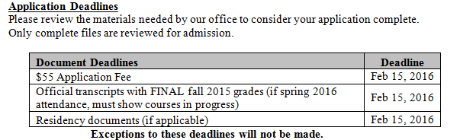
Transfer Admissions Communications
Acknowledgement letter sent within days of Fresno State receiving application during the filing period. Letter instructs students to do the following:
Create Fresno State email account
Submit official college transcripts for EACH institution attended. We will not accept credit for one institution from another institution’s transcript. Failure to report and/or submit an official transcript will result in withdrawal of application. Must show final fall grades and any in progress spring courses
Check To Do List and/or Holds frequently
Provides them with Document Deadlines
Notifies students of University’s impaction level

Slide 11
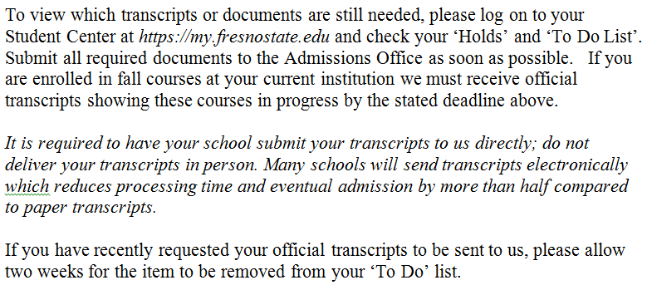
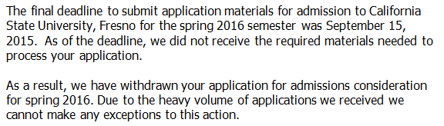
Transfer Admissions Communications (cont)
Document reminders – email sent to students with Incomplete files reminding them that documents are still needed
late January
Withdrawn – email sent to students who did not submit materials by document deadline
mid march
Deny No Space – email sent to students who did not meet our impaction GPA
Sent by Transfer Admissions Advisor after admission review is complete

Slide 12
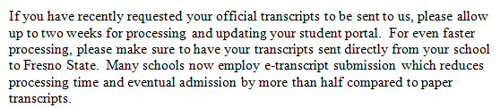
Transfer Admissions Communications (cont)
Notice of Admission (NOA) letter sent after students are admitted. Hard copy sent once a week, usually toward the end of the week.
Manually admitted by Transfer Admissions Advisor
Auto Admitted by a process (begins mid-January)
Insert includes “Important Registration Information and To Do List”
Final official transcript deadline of June 30th reminder for conditionally admitted students who have accepted their admission
end of May
Electronic submission of transcripts = faster processing!

Slide 13
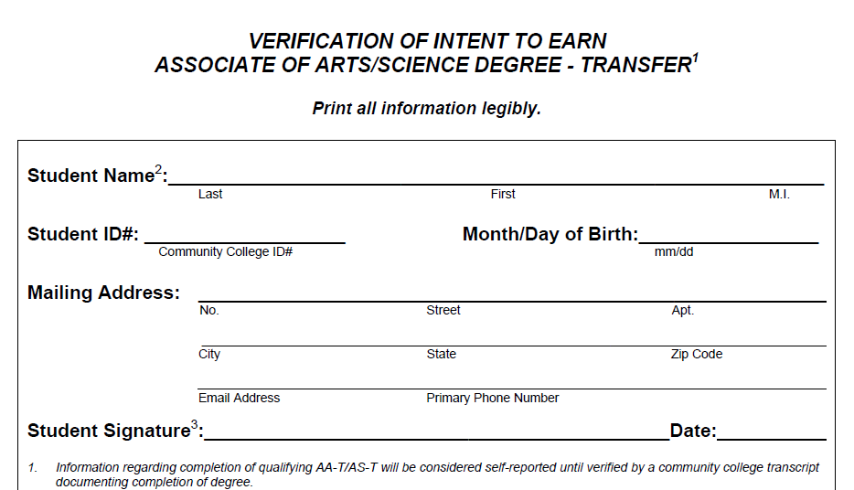
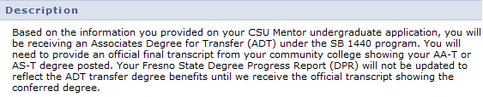
AS-T/AA-T Degree Verification
Verify online!
Will provide students with a .1 GPA increase for admissions purposes only
Notification in Student Center that record will not be updated until final transcript is received showing AS/AA-T

Slide 14
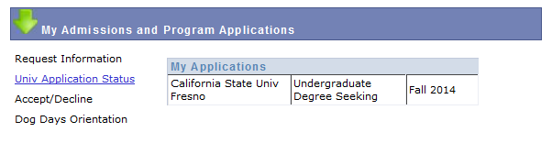
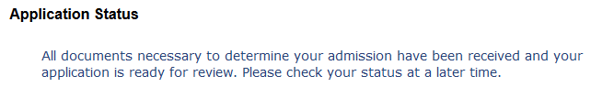
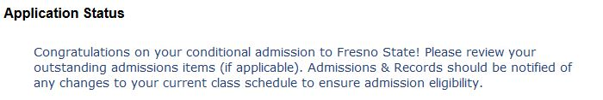
What is your Application Status?
Log into www.my.fresnostate.edu with Fresno State email/password information
Click Student Self Service > Student Center > My Admissions and Program Applications
CLICK

Slide 15
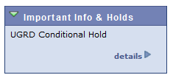
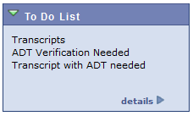
Important Info & Holds/To Do List
Please do not ignore any of the information found
in Important Info & Holds or To Do List. Click on details
to determine what you need to submit
UGRD Conditional Hold for 60 units or Golden 4 will be removed with submission of final unofficial grade form, transcript, screenshot of grades for portal, etc.
Official grades will ONLY be entered with final official transcripts

Slide 16
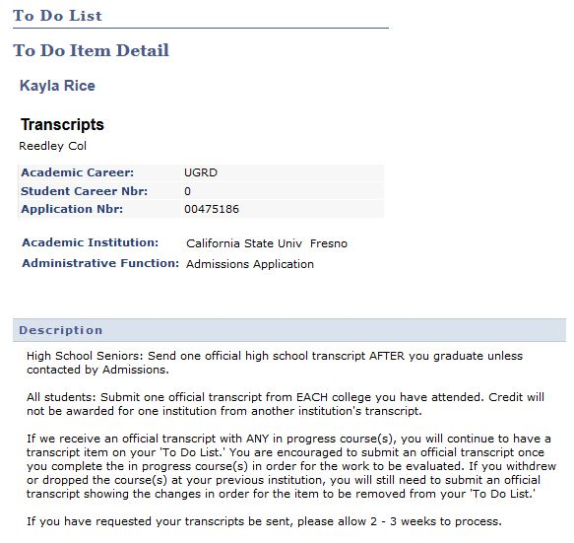
To Do List Details
DUE: JUNE 30th 2016
Requests transcripts to be sent electronically to Fresno State for faster processing! Use imaging@csufresno.edu as the recipient for official transcripts directly from your institution.

Slide 17
ELM & EPT Requirement
Transfer students who have demonstrated successful completion (on an official transcript) of the following General Education areas
A.2 – Written Communication
B.4 – Quantitative Reasoning (Math)
will receive exemptions from the English Placement Test (EPT) and the Entry Level Math (ELM).
Both must be completed with a C or better.
Until official transcripts are received, EPT & ELM will continue to show on your “To Do List.”

Slide 18
Reminders
Consider ALL coursework when pre-advising, including AP work
70 unit community college maximum toward earned units for degree. Units taken after the 70 still count toward GPA and will clear content for degree
Transfer GPA = ALL transferable coursework
Consider repeats of ‘D’ grades when counting a student’s units. Units cannot be counted more than once so be sure to “remove” the units from calculations for earned units. Still count in GPA
If student has attended more than one non-local institution, group those units together. Same applies to attending more than one local college.

Slide 19
Transfer Admissions Advisors Contact Information
Based on student’s last name
A - C Lynn Pappace lpappace@csufresno.edu (559)278-6084
D - H Pam Weiner pweiner@csufresno.edu (559)278-6107
I - M Pang Thao pangt@csufresno.edu (559)278-6086
N-SAL Maria Wilson marwilson@csufresno.edu (559)278-6688
SAM-Z Kelli Cato kcato@csufresno.edu (559)278-6089
All College of Engineering applicants (regardless of last name) Ambar Alvarez Soto ambara@csufresno.edu (559)278-6098
Beginning January 2016, Transfer Admissions Advisors will review applications by College

Slide 20
Questions?
Admissions & Records - Joyal Administration Building
(559) 278-2261 – Admissions Service Windows
admissions@csufresno.edu
Monday – Friday: 8am – 5pm
Transcripts for FALL 2016 admission consideration DUE February 15th 2016
Transcripts for SPRING 2016 admission DUE January 29th
(must include final fall 2015 grades and ADT posted)

