Slide 1
Transferology
Coming to Fresno State soon……

Slide 2
What is it?
Transferology is a nation-wide network designed to help students answer the question "Will my courses transfer?"
Students enter coursework, exams, and/or military learning experiences, then discover in a single click how many schools in the Transferology network have matching courses that may be awarded when the student transfers.
Schools are ranked by the percentage of coursework they accept in transfer for each student, though users can focus the results with a number of handy filters and sorts.
Details of how those courses will count are available with another click or two, and students can inform schools of their interest in transferring by asking about specific programs, campus visits, and/or coursework that has not yet been evaluated by the school.
https://www.transferologylab.com/about.htm

Slide 3

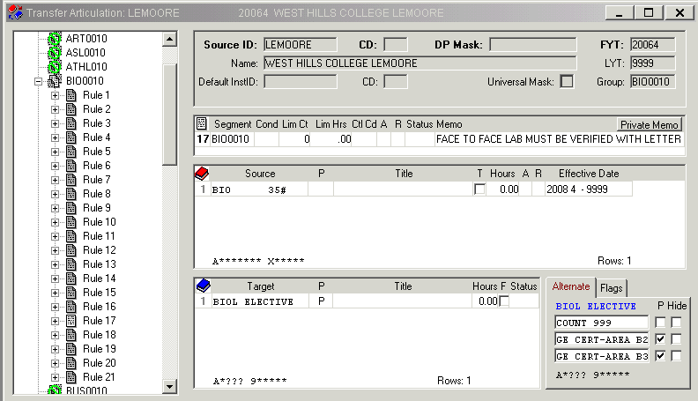
Equivalency Example
Rules in Transferology are coming directly from our database

Slide 4
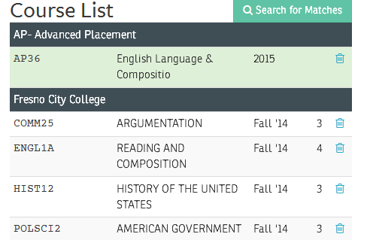
Course Bundles
A course bundle is a collection of courses that any user in Transferology can assemble for the purpose of creating different transfer scenarios for a student.
https://clients.collegesource.com/home/display/TFO/Manage+Course+Bundles

Slide 5
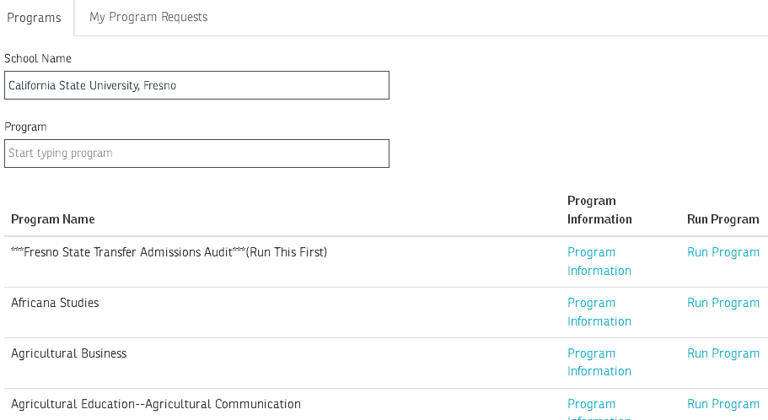
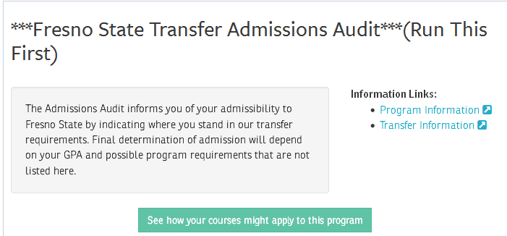
Programs
Create an account

Slide 6
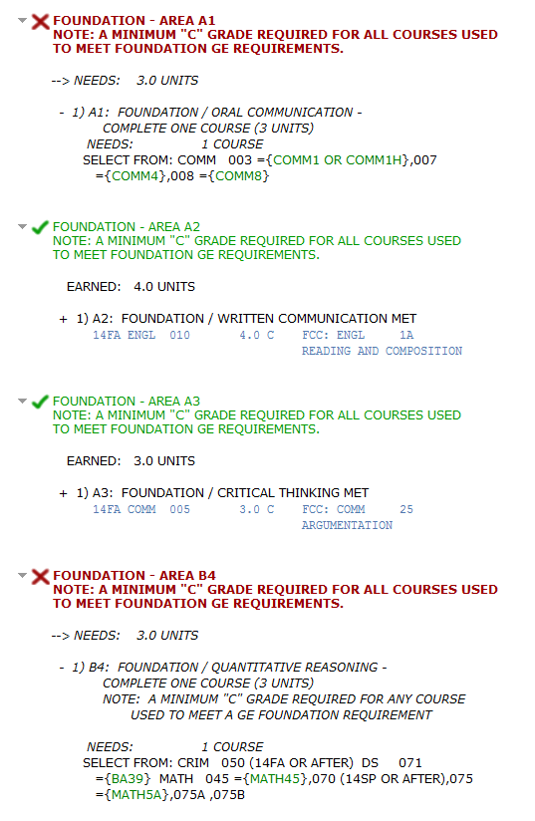
Admissions GE Audit
Courses in green are the courses a student can take at Reedley College which would be considered equivalent to Fresno State courses.

Slide 7
Resources
Transferology User Guide for Advisors
https://clients.collegesource.com/home/display/TFO/Transferology+User+Guide+for+Advisors

