Slide 1

Rick Chacon, M.Ed.
Lyles College of Engineering
Recruitment Coordinator
University Outreach Services
Outreach Counselor
Appt: 559.278.2048 * Cell: 559.906.1550
Email: rickc@csufresno.edu
Engineering East 129
California State University , Fresno – Lyles College of Engineering
Notes:
This PowerPoint template is designed to assist you in creating your own university-branded presentation.
You may alter the text boxes or graphic elements in the template to accommodate your content. Please do not alter the background image.
If you need assistance with this template, please contact the Office of University Communications at 559.278.8595.

Slide 2
Degrees
  Civil Engineering - M.S., B.S.
  Computer Engineering - M.S., B.S., Minor
  Electrical Engineering - M.S., B.S., Minor
  Geomatics Engineering - B.S.
  Mechanical Engineering - M.S., B.S. Construction Management – B.S., Minor
California State University , Fresno – Lyles College of Engineering
Notes:
This PowerPoint template is designed to assist you in creating your own university-branded presentation.
You may alter the text boxes or graphic elements in the template to accommodate your content. Please do not alter the background image.
If you need assistance with this template, please contact the Office of University Communications at 559.278.8595.

Slide 3
Engineering General Education
A1. Select 1 Class
A2. Select 1 Class
A3. Exempt (All Engineering Majors)
B4. Math 75 – Calc. I
B1. Chemistry 3A (Chem. 1A – Mechanical)
B2. Select 1 Class (Bio. 10 – Comp., Elect., & Civil)
B3. Lab. Requirement.
California State University , Fresno – Lyles College of Engineering
Notes:
This PowerPoint template is designed to assist you in creating your own university-branded presentation.
You may alter the text boxes or graphic elements in the template to accommodate your content. Please do not alter the background image.
If you need assistance with this template, please contact the Office of University Communications at 559.278.8595.

Slide 4
Engineering General Education
C1. Select 1 Class (C1 – Exempt for Elect. & Comp.)
C2. Philosophy 1 or 10 (Phil. 20 – Mechanical)
C1 or C2. Exempt (All Engineering Majors)
D1. Select 1 Class
D2. Select 1 Class
D3. Exempt (Econ 40 or 50 – Elect. & Comp.)
E. Exempt (All Engineering Majors)
California State University , Fresno – Lyles College of Engineering
Notes:
This PowerPoint template is designed to assist you in creating your own university-branded presentation.
You may alter the text boxes or graphic elements in the template to accommodate your content. Please do not alter the background image.
If you need assistance with this template, please contact the Office of University Communications at 559.278.8595.

Slide 5
Construction Management G.E.
A1. Select 1 Class
A2. Select 1 Class
A3. Select 1 Class
B4. Math 75 – Calc. I
B1. Physics 4A
B2. Select 1 Class
B3. Lab. Requirement.
California State University , Fresno – Lyles College of Engineering
Notes:
This PowerPoint template is designed to assist you in creating your own university-branded presentation.
You may alter the text boxes or graphic elements in the template to accommodate your content. Please do not alter the background image.
If you need assistance with this template, please contact the Office of University Communications at 559.278.8595.

Slide 6
Construction Management G.E.
C1. Select 1 Class
C2. Select 1 Class
C1 or C2. Exempt
D1. Select 1 Class
D2. Select 1 Class
D3. Economics 40 or 50
E. Exempt
California State University , Fresno – Lyles College of Engineering
Notes:
This PowerPoint template is designed to assist you in creating your own university-branded presentation.
You may alter the text boxes or graphic elements in the template to accommodate your content. Please do not alter the background image.
If you need assistance with this template, please contact the Office of University Communications at 559.278.8595.

Slide 7
70 Unit Limit for Transfer
Course Satisfaction beyond the 70 Unit Limit
  Will receive credit for the course but the units
  Will borrow units from another transferrable class if unit total falls short of the 120 unit requirement for graduation.
California State University , Fresno – Lyles College of Engineering
Notes:
This PowerPoint template is designed to assist you in creating your own university-branded presentation.
You may alter the text boxes or graphic elements in the template to accommodate your content. Please do not alter the background image.
If you need assistance with this template, please contact the Office of University Communications at 559.278.8595.

Slide 8
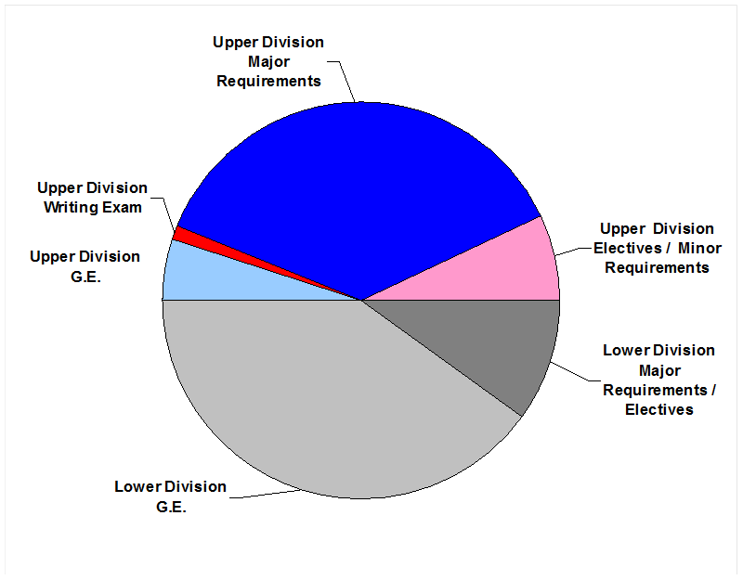
California State University , Fresno – Lyles College of Engineering
Notes:
This PowerPoint template is designed to assist you in creating your own university-branded presentation.
You may alter the text boxes or graphic elements in the template to accommodate your content. Please do not alter the background image.
If you need assistance with this template, please contact the Office of University Communications at 559.278.8595.

Slide 9
When to Transfer?
We support your Engineering Classes
Math Sequence
  If a student is taking math classes at the end of the sequence and nothing else; consider transferring in order to take the non-articulated classes.
California State University , Fresno – Lyles College of Engineering
Notes:
This PowerPoint template is designed to assist you in creating your own university-branded presentation.
You may alter the text boxes or graphic elements in the template to accommodate your content. Please do not alter the background image.
If you need assistance with this template, please contact the Office of University Communications at 559.278.8595.

Slide 10
Physics
Physics 4A, 4B, and 4C are need for all Engineering Majors except Civil. It is an option for Geomatics Engineering (GME 23L or Physics 4C)
Physics 4A and 4B are need for Civil; Physics 4C does not override 4B.
California State University , Fresno – Lyles College of Engineering
Notes:
This PowerPoint template is designed to assist you in creating your own university-branded presentation.
You may alter the text boxes or graphic elements in the template to accommodate your content. Please do not alter the background image.
If you need assistance with this template, please contact the Office of University Communications at 559.278.8595.

Slide 11

California State University , Fresno – Lyles College of Engineering
Notes:
This PowerPoint template is designed to assist you in creating your own university-branded presentation.
You may alter the text boxes or graphic elements in the template to accommodate your content. Please do not alter the background image.
If you need assistance with this template, please contact the Office of University Communications at 559.278.8595.

Slide 12

California State University , Fresno – Lyles College of Engineering
Notes:
This PowerPoint template is designed to assist you in creating your own university-branded presentation.
You may alter the text boxes or graphic elements in the template to accommodate your content. Please do not alter the background image.
If you need assistance with this template, please contact the Office of University Communications at 559.278.8595.

Slide 13
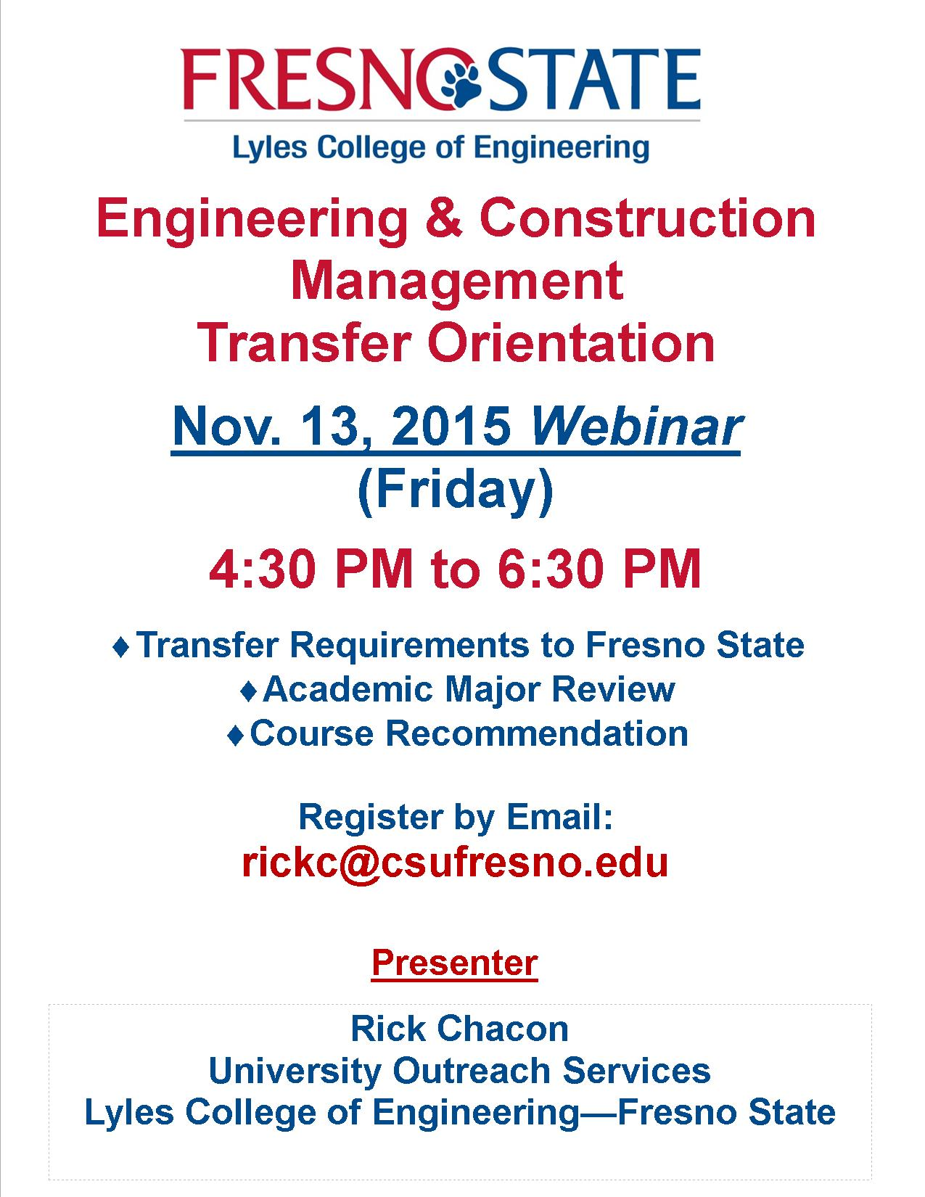
California State University , Fresno – Lyles College of Engineering
Notes:
This PowerPoint template is designed to assist you in creating your own university-branded presentation.
You may alter the text boxes or graphic elements in the template to accommodate your content. Please do not alter the background image.
If you need assistance with this template, please contact the Office of University Communications at 559.278.8595.

Slide 14
Thank you for sending us your well-prepared students. Our success is rooted in the good work that you do.
Thanks again,
California State University , Fresno – Lyles College of Engineering
Notes:
This PowerPoint template is designed to assist you in creating your own university-branded presentation.
You may alter the text boxes or graphic elements in the template to accommodate your content. Please do not alter the background image.
If you need assistance with this template, please contact the Office of University Communications at 559.278.8595.

