Slide 1


Community College Counselors Conference

Slide 2
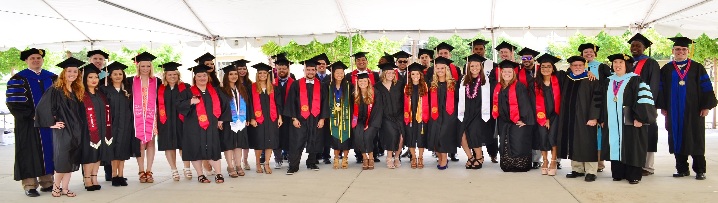
College of Health and Human Services
College Mission
"To provide a professionally oriented education at the undergraduate level and to provide graduate programs in specialized disciplines that serve the needs of students - as well as foster the emerging needs of residents and health and human service providers in the Central California region."

Slide 3
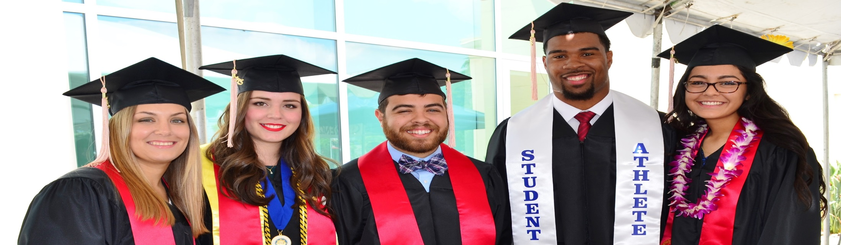
Pride of Our College
According to the Office of Institutional Effectiveness, the students in our college make up 21% of the entire Fresno State student body
Our college offers two out of the three total doctoral programs on campus - Doctor of Physical Therapy and Doctor of Nursing Practice.
We graduate more majors than any other college at Fresno State
We make up 34% of the total amount of grants awarded to the University
71% of our incoming freshman are the first in their families to attend college

Slide 4
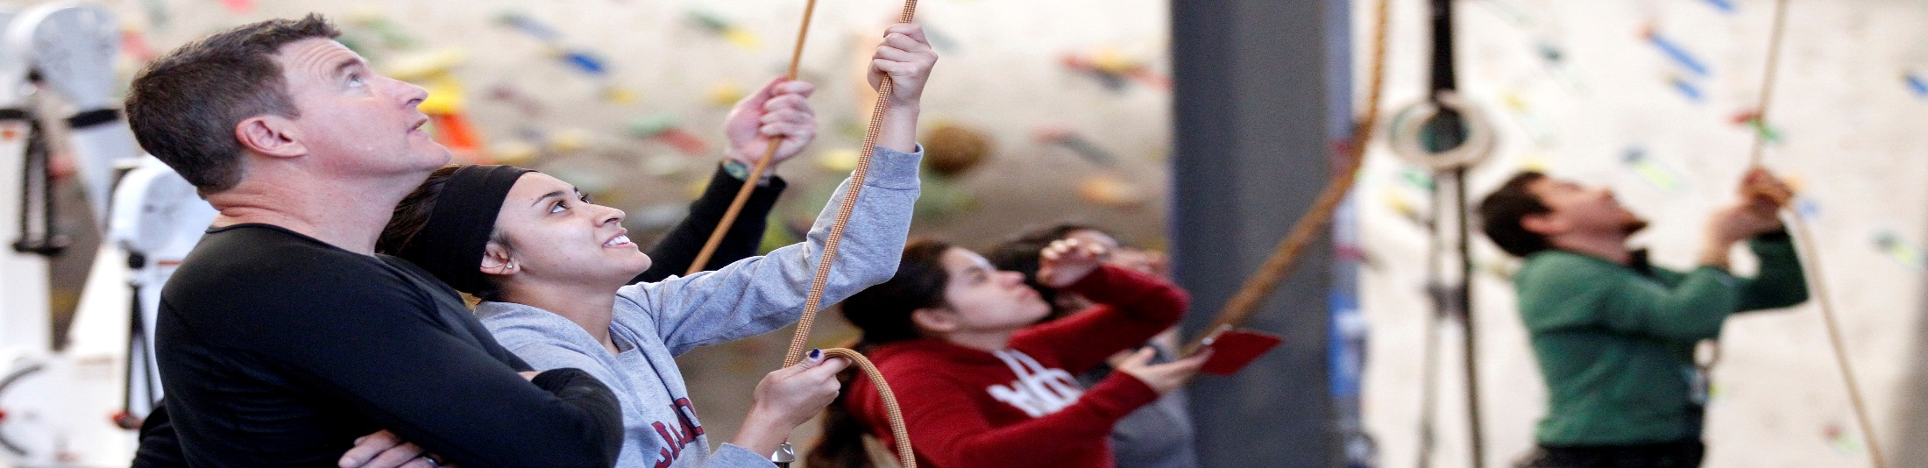
Departments
Communicative Disorders & Deaf Studies
Kinesiology
Physical Therapy
Public Health
Recreation Administration
Social Work Education & Gerontology
School of Nursing

Slide 5
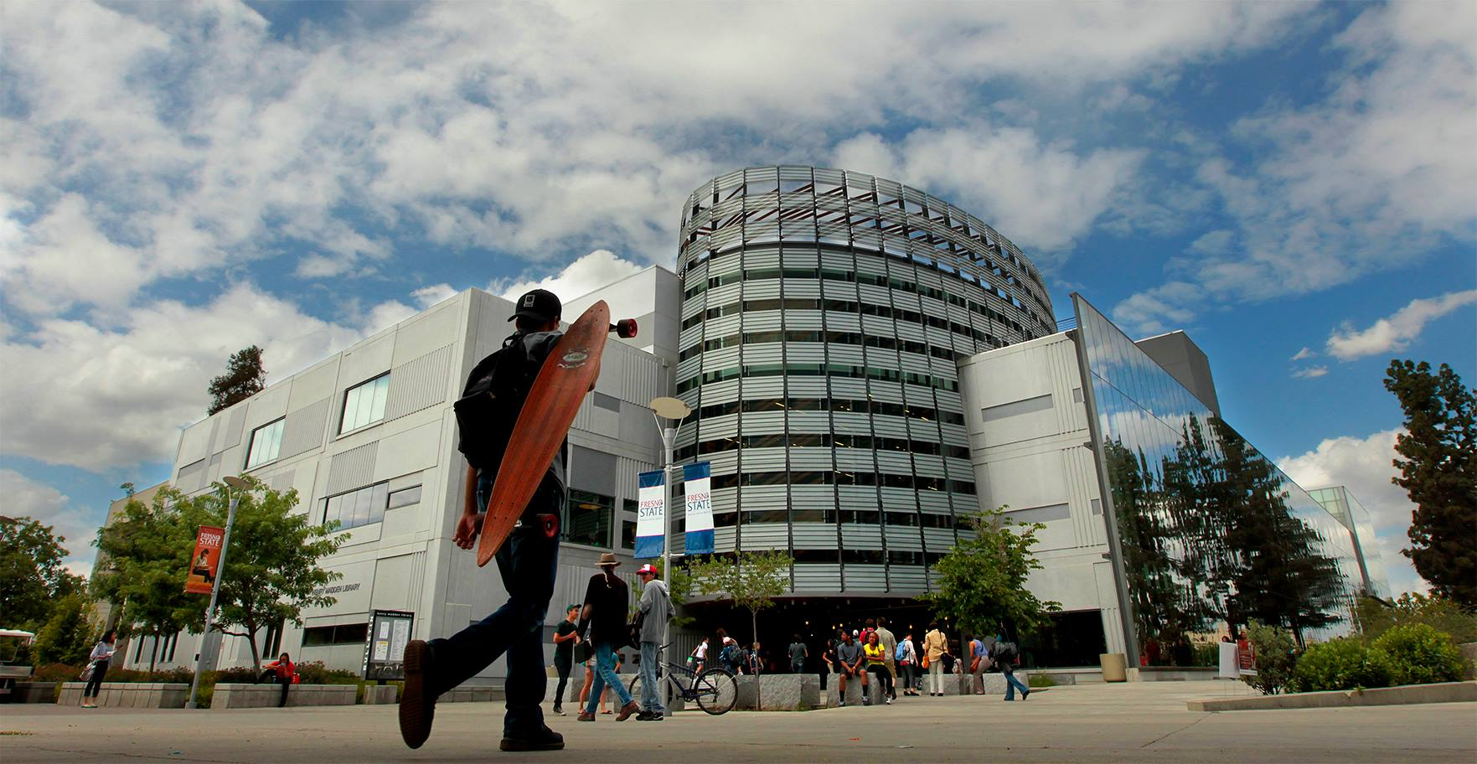
Overview
Pre-Athletic Training
Pre-Nursing
Pre-Social Work
Q&A

Slide 6
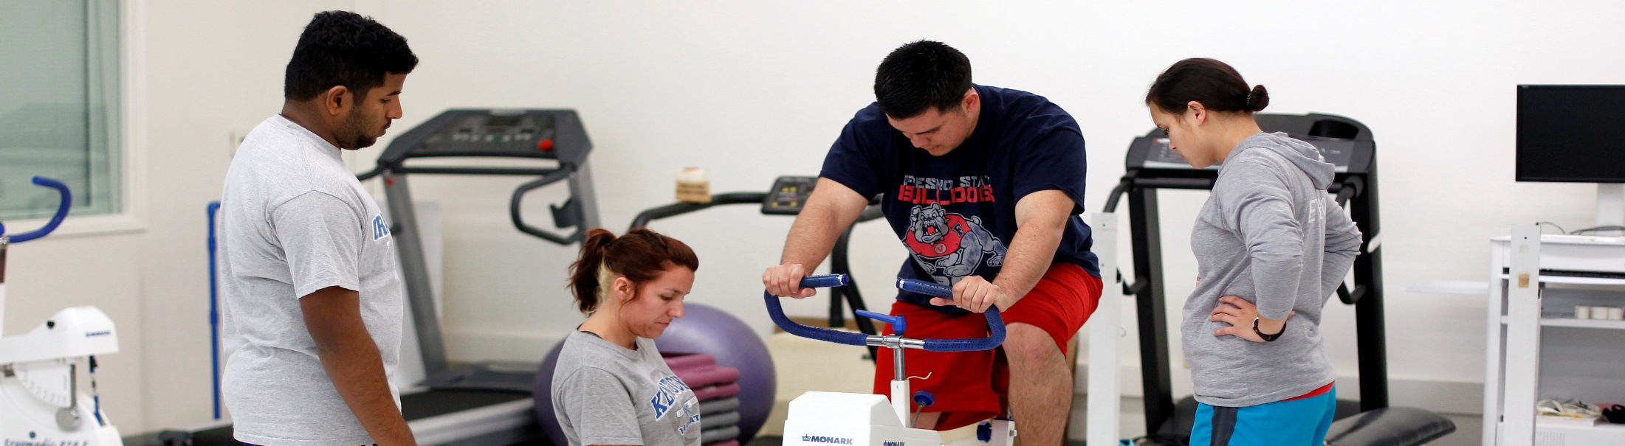
Pre-Athletic Training

Slide 7

Admissions Requirement
Applying to the BSAT
No more than 2 prerequisite courses can be in-progress at the time of application along with a minimum of 200 hours experience observing a certified athletic trainer completed
Specific health criteria must be met
GPA
Overall GPA of 2.75 or higher
Prerequisite GPA of 3.0 or higher
10 prerequisite courses must be completed or be in progress prior to application

Slide 8
Pre-Athletic Training
Prerequisites
Prerequisite Courses | Course Title | Units
G.E. Area A1* | Oral Communication | 3
G.E. Area A2* | Written Communication | 3
G.E. Area B2* | Life Science | 3
G.E. Area B4* | Quantitative Reasoning | 3
G.E. Area E* | Lifelong Understanding & Self-Development | 3
Human Anatomy w/lab | BIOL 64 | 3 or 4
Human Physiology w/lab | BIOL 65 | 5
Introduction to Athletic Training | KINES 38 | 3
Pre-Observation in Athletic Training | KINES 43 or completion of at least 200 clinical observation hours in a setting employing a certified athletic trainer | 1
First Responder and Emergency Care | PH 48 or PH 49 (Emergency Medical Technician) | 3
* See G.E. list for approved courses.

Slide 9
Admissions Requirement
Prerequisite Courses
Each prerequisite must be completed with a minimum “C” grade
CR/NC grades are not acceptable except in courses designated CR/NC grading only
A maximum of 2 different prerequisite courses may be repeated once to improve grade
On-line, web-based or distance learning science and laboratory courses taken at other institutions must be approved by the Athletic Training Program Director

Slide 10
Application Deadline
FALL SEMESTER ENTRY
Applications are due February 1st
Applications are due each year for the following Fall semester.

Slide 11
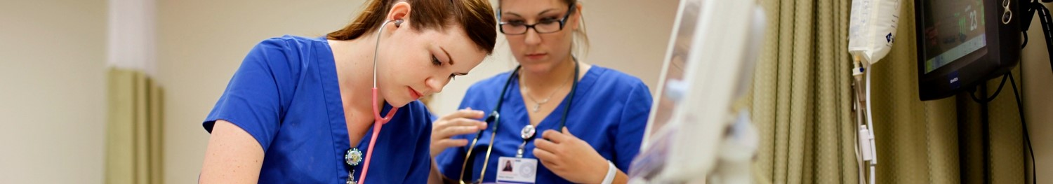
Pre-Nursing

Slide 12
Pre-Nursing Prerequisites
Grades in these courses are calculated for Nursing Admissions:
Prerequisite Courses | Course Title | GE Requirements
Oral Communication | COMM 3, 7, or 8 | A1
Written Communication | ENGL 5B or 10 | A2
Critical Thinking | SOC 3 *Recommended. Meet CT and Additional Requirements. | A3
Quantitative Reasoning | MATH 11 or PH 92 *Firm prerequisite. | B4
General Chemistry | CHEM 3A | B1 & B3
Human Anatomy | BIOL 64
Human Physiology | BIOL 65
Introductory Microbiology | BIOL 20 | B2
Each prerequisite must be completed with a minimum grade of “C” or better.
CR/NC grades are NOT accepted.
Online Science courses are NOT accepted.

Slide 13
Additional Requirements
Grades in these courses are NOT calculated for Nursing Admissions:
Prerequisite Courses | Course Title | GE Requirements
Critical Thinking | SOC 3 | A3
Moral Questions or Contemporary Conflicts of Morals | PHIL 20 or PHIL 120 | C2 or IC
Introduction to Psychology | PSYCH 10 | D3
Life Span Development | CFS 38 | E
Nutrition & Health: Realties and Controversies | NUTR 53 | E
Required to graduate from the Nursing program.
Must be completed with a “C” or better and should take no later than 2nd semester of Nursing program.

Slide 14
Admissions Requirements
Minimum Admissions Requirement
GPA
Overall GPA of 3.0 or higher
Prerequisite GPA of 3.0 or higher
Maintain a competitive prerequisite GPA of 3.7 – 4.0
Student are ranked by GPA and admitted as space allows
Test of Essential Academic Skills (TEAS)
Score a 75% or higher
Can take the TEAS a maximum of 3 times
Students will be allowed to take the TEAS beyond the 3 attempts, only after 5 years have passed from their first attempt
**Veterans Preference - 3.0 in 8 prerequisites & overall GPA (DD214 in last 4 years)
*Impaction for both BSN and RN to BSN programs

Slide 15
Nursing Application Deadline
FALL Entry: March 1 - 31st
(Prerequisites are required to be completed the previous Fall)
Admissions cycle open to ALL eligible applicants.
SPRING Entry: August 1 – 31st
(Prerequisites are required to be completed the Summer prior)
Admissions cycle open to all eligible Fresno State student applicants. Eligible applicant must be currently enrolled fulltime in courses at Fresno stated for at least 1 semester. Eligible Post-Baccalaureate applicants are to have graduated from Fresno State.
Apply to Fresno State online only: www.csumentor.edu
Apply to Nursing online only: www.nursingcas.org

Slide 16
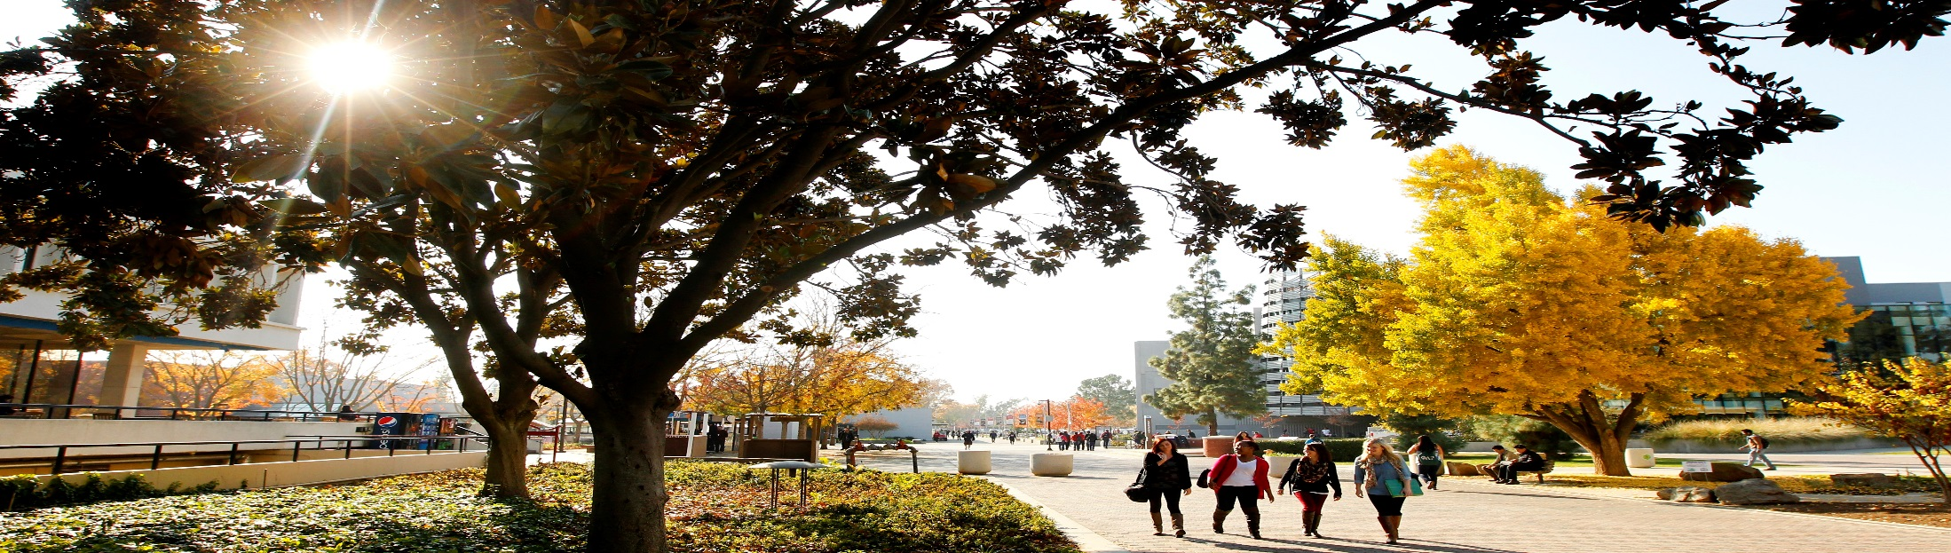
Pre-Social Work

Slide 17

Program Entry Requirements
Social Work Program Entry
Prerequisites
Must successfully complete the Pre-Social Work major prior to being permitted to enroll in restricted and sequenced 100-level Social Work courses
All prerequisites must be completed prior to entry into the Social Work program.
Cohort of Social Work students begin the program in the Fall semester
No Social Work students are permitted to begin the program in the Spring Semester
GPA
Overall GPA of 2.5 or higher for all Lower Division General Education courses
Prerequisite GPA of 2.7 or higher

Slide 18
Pre-Social Work
Prerequisites
Prerequisite Courses | Course Title | Units
G.E. Area A1* | Oral Communication | 3
G.E. Area A2* | Written Communication | 3
G.E. Area A3* | Critical Thinking | 3
G.E. Area B4* | Quantitative Reasoning | 3
G.E. Area D2* | American Government | 3
G.E. Area D3* | Social Science (ECON 25, 40 or 50) | 3
G.E. Area E* | Lifelong Understanding & Self-Development (PH90) | 3
SWRK 20 | Introduction to Social Work | 3
* See G.E. list for approved courses.

Slide 19
Additional Information
Community College Transfers
The Department of Social Work Education will honor articulation agreements between community college districts and Fresno State for equivalent courses meeting the G.E. requirements for Areas A1, A2, A2, B4 and D2.
Students transferring to Fresno State should plan on attending Dog Days Orientation sessions. Schedule an advising appointment for B.A. Coordinator for Social Work.

Slide 20
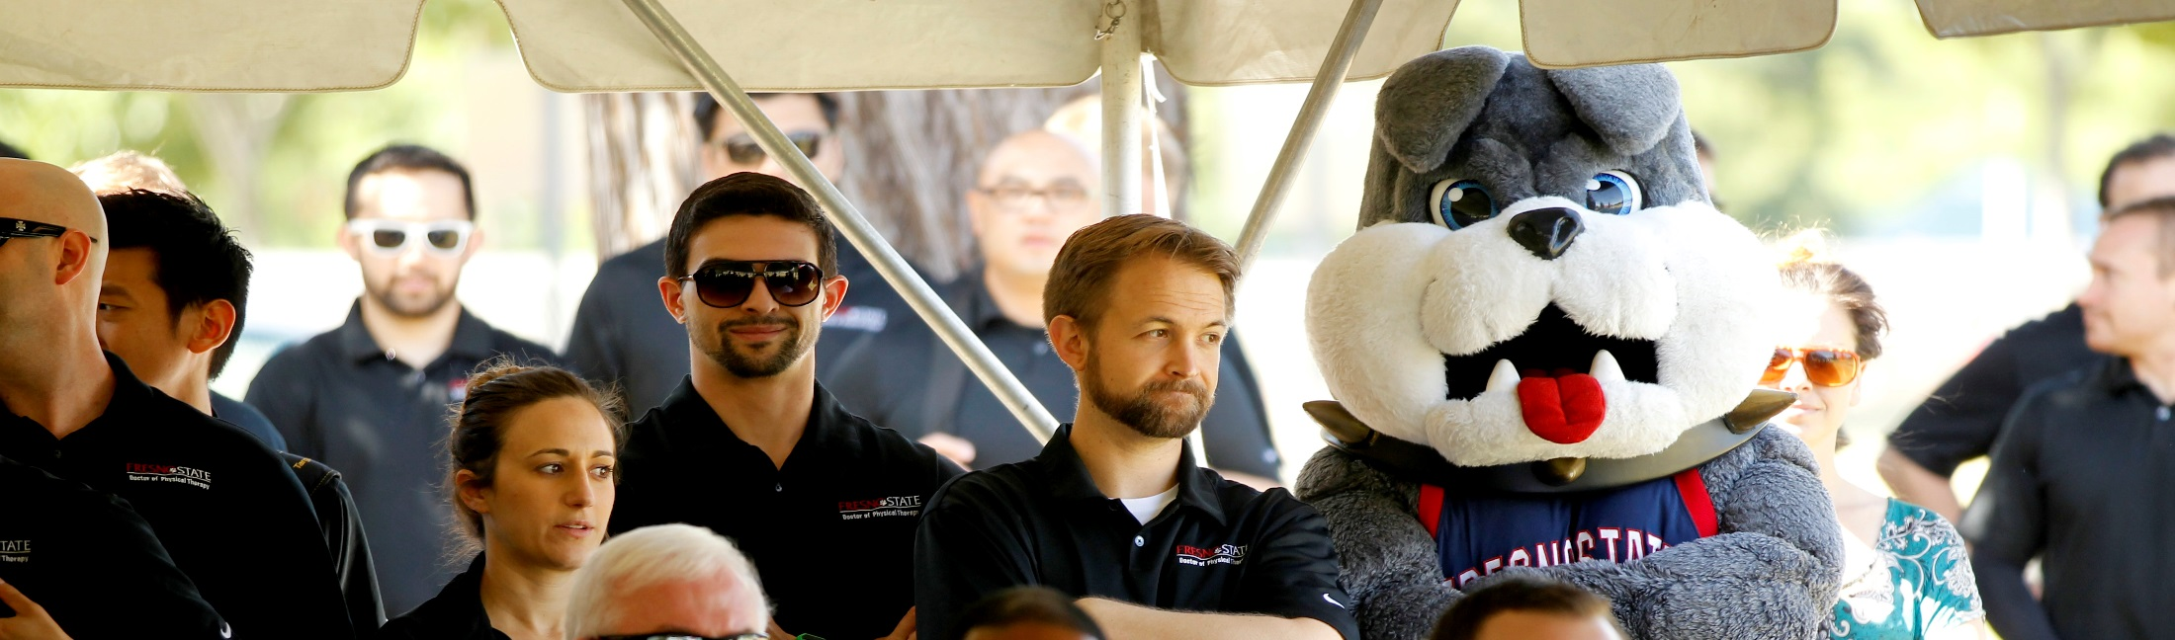
QUESTIONS?

Slide 21
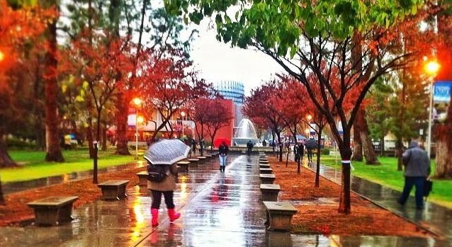

Academic Counselors Nursing Admissions Coordinators Frank Castro frankyc@csufresno.edu Robert PageSmith rpagesmith@csufresno.edu Shimel Saychou ssaychou@csufresno.edu Grace Castaneda gcastaneda@csufresno.edu College of Health and Human Services Advising and Career Development Center McLane Hall 194 (559) 278-5027
Contact Us

