Slide 1
CSU Application Process for AB540 Students 2015-2016
By:
Raúl Z. Moreno
Coordinator
University Migrant Services
California State University, Fresno
raulm@csufresno.edu
559-278-5750
5150 N. Maple Avenue M/S JA62
Fresno, California 93740-8026

Slide 2
Assembly Bill 540
Requirements:
Must attend at least three years and graduate from a California high school.
Students must sign an affidavit stating their California residency.
The law requires that all information must be handled in a confidential manner.

Slide 3
Assembly Bill 2000
AB2000 expands the eligibility for AB540. Students that attended 3 years of K-12 education in California and meet the rest of the AB540 requirements, may also qualify for AB540.

Slide 4
CSU Application
Apply to your selected CSU online at www.csumentor.edu by November 30th
Click on “Create an Account”
Click on “Apply Online”
Click on “Undergraduate Online Application”
Click on “Fall 2015”
When asked for your Social Security Number, enter your DACA SSN. If you do not have one, leave it blank
When asked about your citizenship status, choose, “None of the Above”

Slide 5
CSU Application Cont.
Question # 4- California State Residency
What U.S. State/Territory do you regard as your permenant home?
The answer should be “CALIFORNIA”.
Do you claim California Residency?
Answer: YES. The question is about where you live.
Have you lived in California continuously since birth?
Answer: NO (Answer with complete details)

Slide 6
CSU Application Cont.
Make sure you have included all courses: past, present and future. All together they should total the requirements for admission.
When completing question #11 of the Admissions application, also apply for EOP, Educational Opportunity Program, when asked if you are interested in applying to EOP, say “YES.”
At the end of the process you will see a link and be asked to complete the actual EOP application.

Slide 7
Educational Opportunity Program
After you receive the Conformation Page, at the bottom of the page you will see a link taking you directly to Educational Opportunity Program link.
Click the link and fill out the entire application.
If you qualify, you will be eligible to receive a grant and various services.
It is a good idea to have the names and e-mail addresses of the teachers or counselors that will recommend you.

Slide 8
Educational Opportunity Program
Confirm that EOP received your application.
Statewide Info: 1-800-468-6927
For Fresno State Applicants ONLY: (559) 278-6025

Slide 9
CSU Application Fee Waiver
Apply for the Fee Waiver.
Complete the worksheet to see if you qualify.
If you qualify, Congratulations!
If not do not qualify, pay the $55 application fee.
Submit and keep a copy of the confirmation page.

Slide 10
Residency Requirements
To qualify as an AB540 student, you must submit a copy of your high school transcript to your selected CSU and submit an AB540 affidavit to clear residency before December.

Slide 11
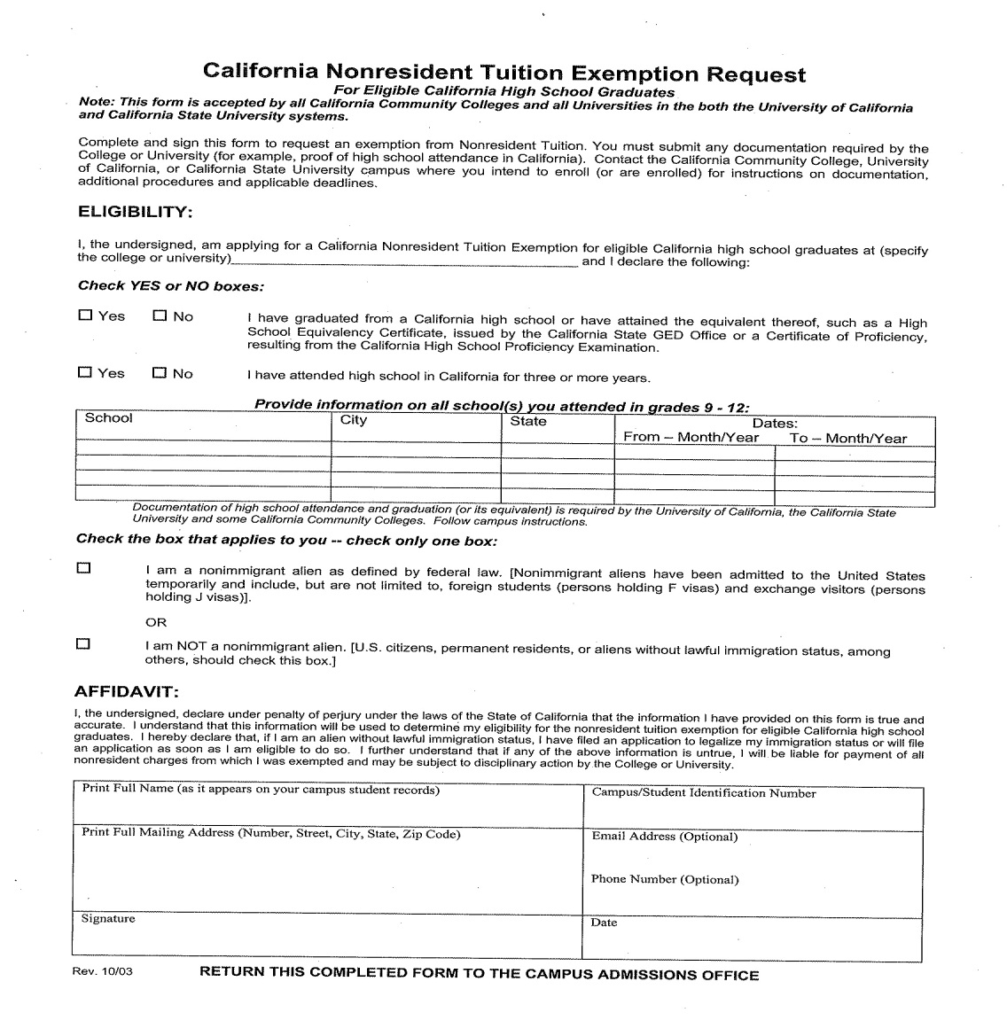
California Nonresident Tuition Exemption Request For Eligible California High School Graduates

Slide 12
University Scholarships
Apply for university scholarships at your local campus.
For example:
www.csufresno.edu/scholarships

Slide 13
University Migrant Services
If you plan to attend Fresno State,
apply to University Migrant Services at www.csufresno.edu/ums
You can email it to raulm@csufresno.edu
Or mail to:
University Migrant Services
5150 N. Maple Avenue JA62
Fresno, CA 93740
(559) 278-5750
raulm@csufresno.edu

Slide 14
Education and Leadership Foundation
Apply to the Education and Leadership Foundation. They will help you with scholarships, internships and leadership development activities.
Education and Leadership Foundation
4290 E. Ashlan Avenue
Fresno, CA 93726
(559) 291-5428
www.education-leadership.org

Slide 15
Teaching Fellows Foundation
If you are looking for a job or internships, you can also contact the Teaching Fellows Foundation
Mike Snell - Executive Director
Mike@ctff.us
1177 E Shaw Avenue Suite 101 Fresno, CA 93710
Ph. (559) 224-9200 Fax (559) 224-9204
http://ctff.us

Slide 16
Private Scholarships
Apply for private scholarships. You can get a current list at:
www.education-leadership.org
Regularly check with your high school counselor and career center.

Slide 17
Support Programs
Apply for support programs that apply to you, for example:
Educational Opportunity Program (EOP)
Health Career Opportunities Program (HCOP)
Lyles College of Engineering Pathways: Student Services (Pathways)
Science, Technology, Engineering, and Mathematics (STEM)
California State University Louis Stokes Alliance for Minority Participation (LSAMP)
CA Mini Corps

Slide 18
English Placement Test (EPT) & Entry Level Mathmatics (ELM)
You must register and take the EPT/ELM.
If you score less than 147 in the EPT, you will have to take English remediation during the spring or summer.
If you score less than 50 in the ELM, you will have to take a Math remediation class prior to your enrollment.
To register for EPT/ELM go to www.csufresno.edu/testing

Slide 19
Early Start Program
Students that score less than 147 in the EPT or less than 50 in the ELM must complete a summer class, in that subject, prior to enrollment in the university.
www.fresnostate.edu/eap
To be exempt from the EPT, you need to score a 500 or higher on the SAT or score a 22 or above on the ACT, of the English portion.
To be exempt from the ELM, you need to score a 550 or higher on the SAT or score a 23 or higher on the ACT, of the Math portion.

Slide 20
California Dream Act
AB540 Students must apply for California Financial Assistance at www.caldreamact.org (AB 131)
All students must apply beginning on January 1st through March 2nd.

Slide 21
California Dream Act cont.
Cal Grant information will be sent to the college selected as your first choice. If you decide to go to a different college or university you must inform the California Student Aid Commission, so they can send your information to the right college or university.

Slide 22
FAFSA
U.S. Citizens and Permanent Residents must complete the FAFSA at www.fafsa.ed.gov
All students must apply beginning on January 1st through March 2nd.

Slide 23
Intent to Enroll
Fresno State will send you an email asking you to confirm your intent to Enroll in the University. You need to reply by May 1st.

Slide 24
Dog Days
All admitted students are required to register for Dog Days New Student Orientation in order to register for classes.

Slide 25
Fresno State Email
Create your Fresno State email account by using your full name, as your username.
For example, raulzmoreno@mail.fresnostate.edu
Also, learn how to use your student center at www.my.csufresno.edu, by using your Fresno State email user name and password.
Check it constantly, especially your To Do List.

Slide 26
Tuition Installment Plan
Fresno State tuition is generally due the last Friday of July and the first Friday of December.
An installment plan (2 payments) is available if you apply for it in Joyal 181.

Slide 27
Deferred Action for Childhood Arrivals (DACA)
DACA provides an opportunity for eligible students between the ages of 15 and 30 to obtain an employment authorization, social security card and qualify for a California identification or driver’s license.

Slide 28
Deferred Action for Childhood Arrivals (DACA) Qualifications
Were under the age of 31 as of June 15, 2012;
Came to the United States before reaching your 16th birthday;
Have continuously resided in the United States since June 15, 2007, up to the present time;
Were physically present in the United States on June 15, 2012, and at the time of making your request for consideration of deferred action with USCIS;
Entered without inspection before June 15, 2012, or your lawful immigration status expired as of June 15, 2012;
Are currently in school, have graduated or obtained a certificate of completion from high school, have obtained a general education development (GED) certificate, or are an honorably discharged veteran of the Coast Guard or Armed Forces of the United States; and
Have not been convicted of a felony, significant misdemeanor, three or more other misdemeanors, and do not otherwise pose a threat to national security or public safety.

Slide 29
Deferred Action for Childhood Arrivals
If you qualify, apply for Deferred Action. For more information go to: www.uscis.gov/childhoodarrivals
Information in Spanish at:
www.uscis.gov/acciondiferida

Slide 30
DACA APPLICATION PROCESS
The following are the forms and evidence that need to be completed and submitted:
G-1145 – Notification of Application/Petition Acceptance
I-821 D – Consideration of Deferred Action for Childhood Arrivals
I-765 – Application for Employment Authorization
I-765 WS – Worksheet Establishing Your Economic Need for Employment
Evidence supporting the seven qualifications
Additional evidence

Slide 31
Steps to Follow for DACA
1. Analyze the application. Find the application at: www.uscis.gov/childhoodarrivals
2. Read and understand all the instructions.
3. Gather pertinent documentation.
4. Organize your application packet.
5. Seek legal counsel, if necessary.
6. Mail your application packet with all items on the check list and application fee.

Slide 32
DACA Evidence
You must submit evidence for each one of the qualification requirements.
Examples:
A. Identifications
B. School Records
C. Financial Records
D. Medical Records
E. Community Service
F. Employment Records
Make sure you cover all required areas.
You will also need a translated birth certificate

Slide 33
Deferred Action Help Center
If you need information or assistance with your DACA Application, you may go to:
Deferred Action Help Center
4290 E. Ashlan Avenue
Fresno, CA 93726
(559) 291-5428
www.education-leadership.org

Slide 34


Closing Remarks
“ Dare to be who you want to be.”
“Atrevete a ser lo que quieres ser.”
Raúl Z. Moreno
Coordinator
University Migrant Services
California State University, Fresno
raulm@csufresno.edu
559-278-5750
5150 N. Maple Avenue M/S JA62
Fresno, California 93740-8026

