Slide 1
Early Start Program SUMMER 2014 How to Register and Pay Online
For more information on the Early Start Program and to view video tutorials, go to
www.gotofresnostate.com
After viewing this presentation, if you still need assistance with registration or online payment, call the Student HELP desk at 278-7000.
Monday – Friday Saturday
7 am to 9 pm 8 am to 5 pm
Summer Hours May 19 - August 8
Monday – Saturday
7 am to 6 pm
Continuing & Global Education
559-278-0333
www.csufresno.edu/cge

Slide 2
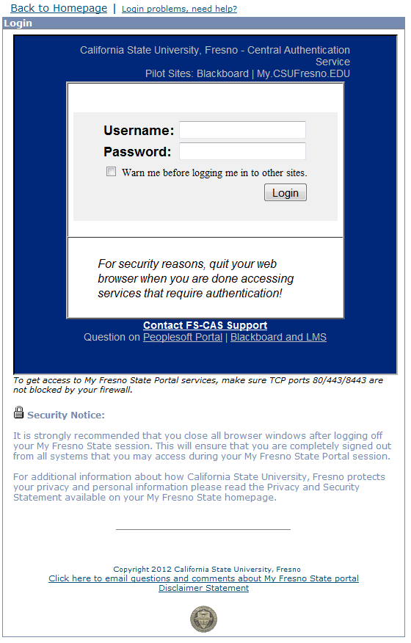
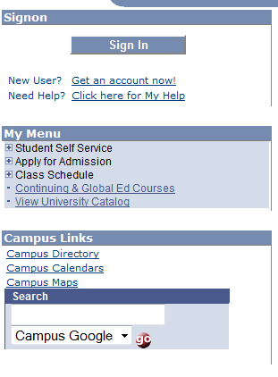
Go to https://my.csufresno.edu
Log in
Enter your
Username and Password

Slide 3
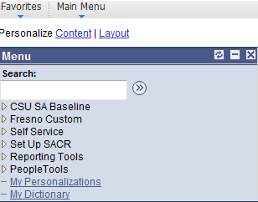
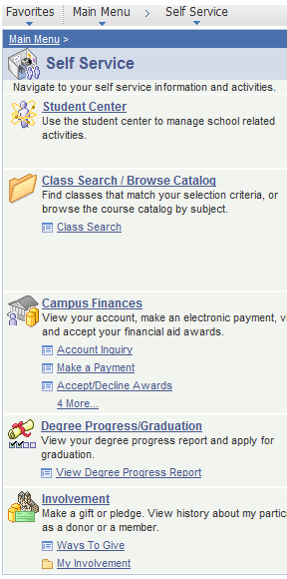
Click on “Self Service”
Getting Started
Then Click on “Student Center”

Slide 4
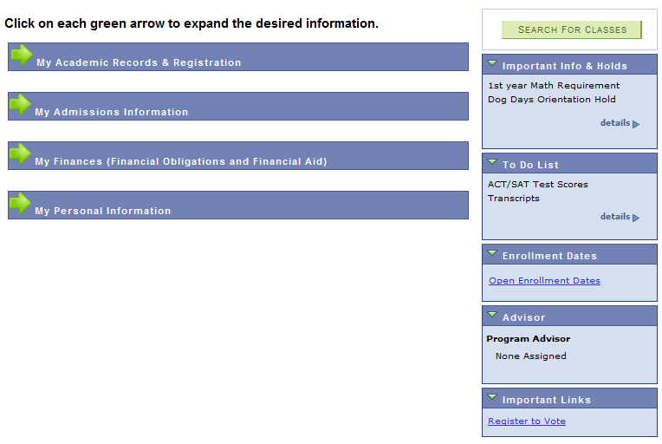
Make a Selection
Click on the green arrow

Slide 5
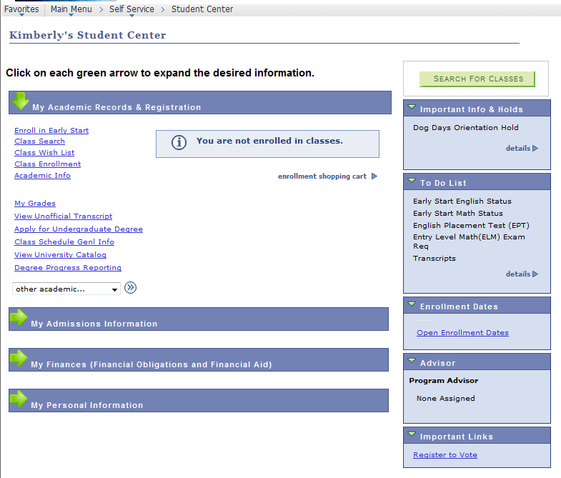
Enroll in Early Start
Click on “Enroll in Early Start”
Your Name Here

Slide 6
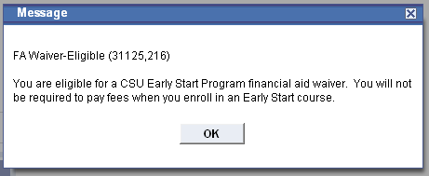
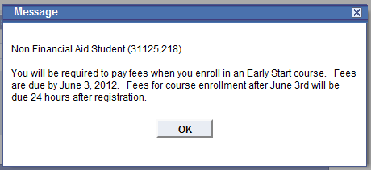
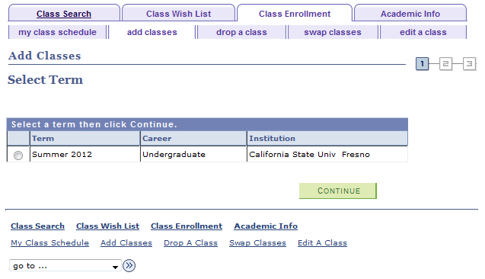
Select the term and Click “Continue”
Term is Summer 2014
One of these messages will pop up

Slide 7
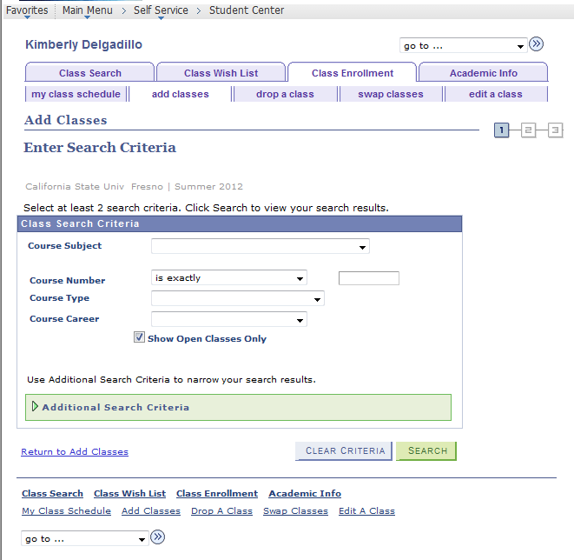
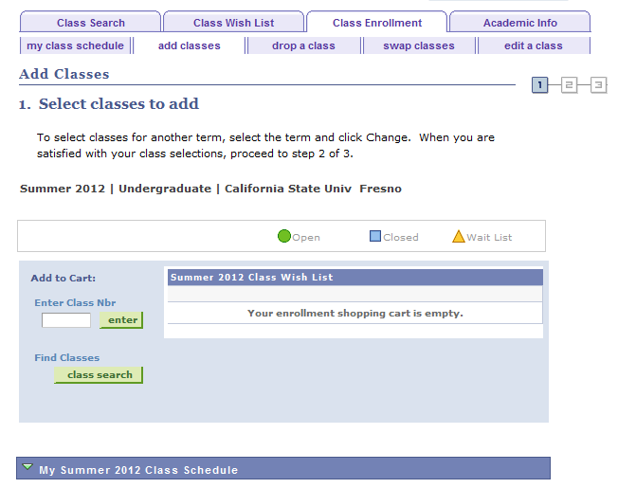
Select Classes to Add
Make a selection for
Course Subject
● Early Start English
● Early Start Math
Fill in the Course Number
● 1 for 1 unit
● 3 for 3 units
IF you were given a 5 digit class number, enter it now. Otherwise, Click on “Class Search”

Slide 8
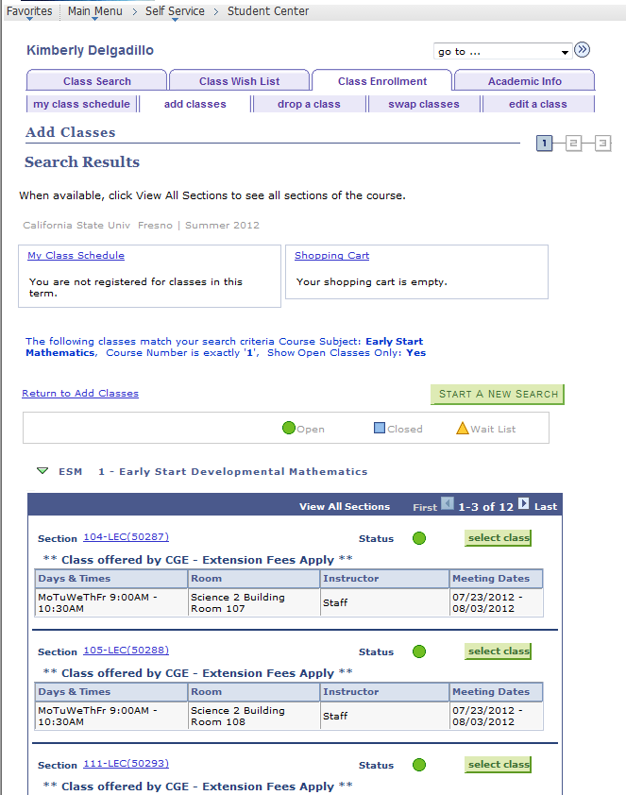
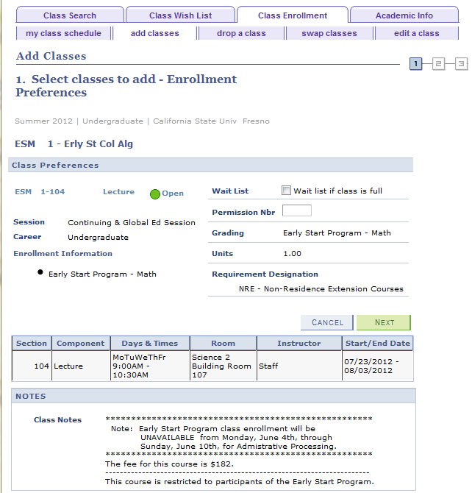
Select your course
IF you were given a permission number, enter it now. Otherwise, Click on “Next”
Select the class you want to enroll in

Slide 9
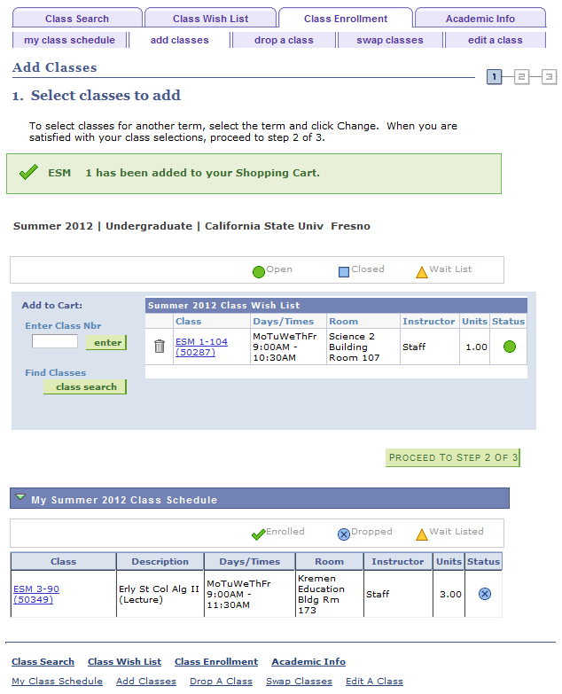
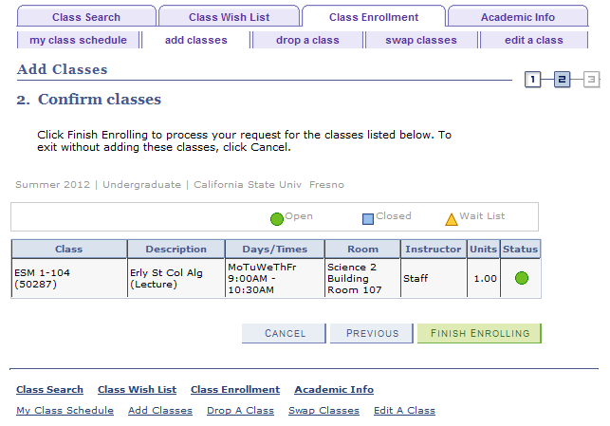
Finish Enrolling

Slide 10
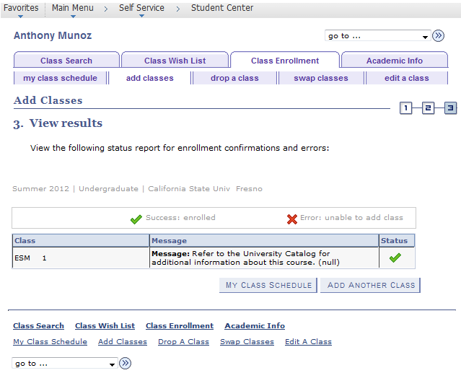
A message will pop-up for FA Waiver-Eligible OR Non Financial Aid Student Click OK
Success: enrolled
If you need to make a payment, go back to the Student Center.

Slide 11
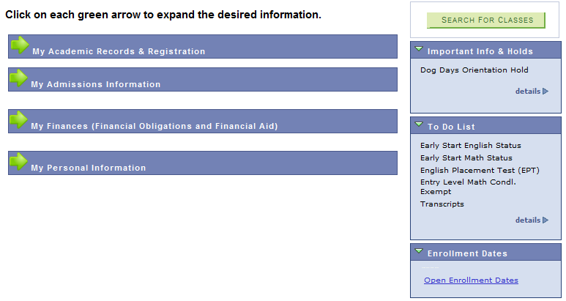
How to Pay
Go to
“My Finances”
to pay your fees

Slide 12
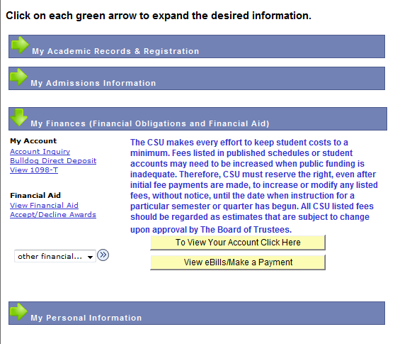
What are your fees

Slide 13
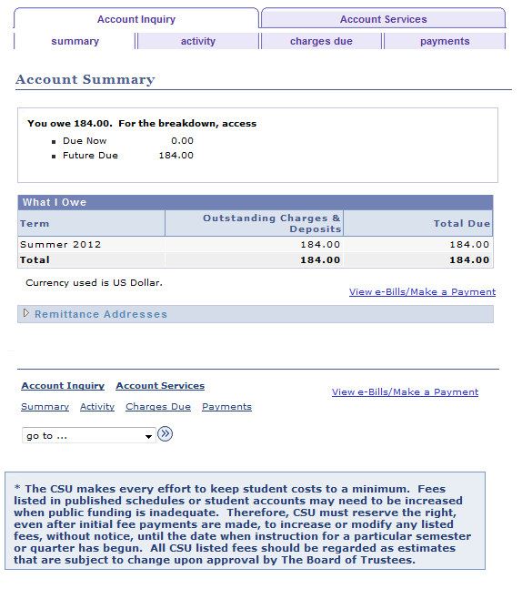
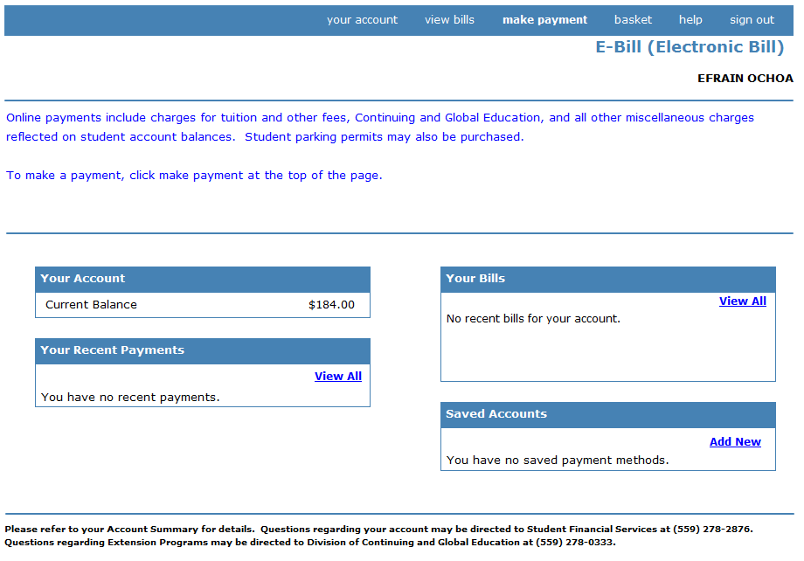
Make a Payment
Click on “View e-Bills/Make a Payment” to make a payment online
Click on “Make a Payment”

Slide 14
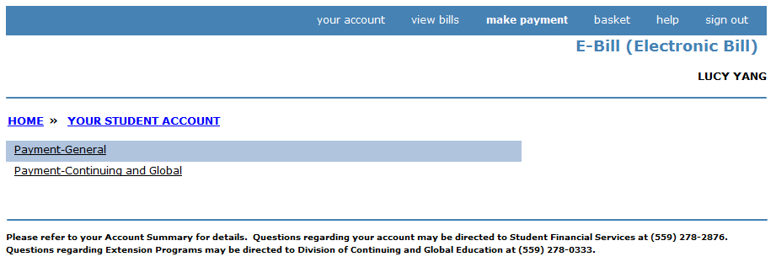
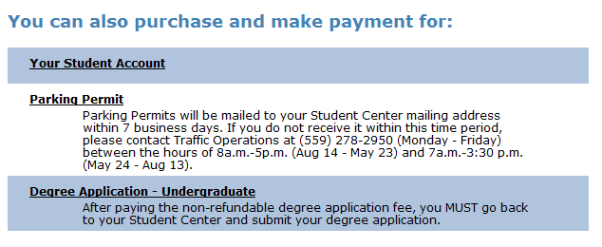
Make payment to
Continuing & Global Education
Make the payment to “Payment-Continuing and Global”

Slide 15
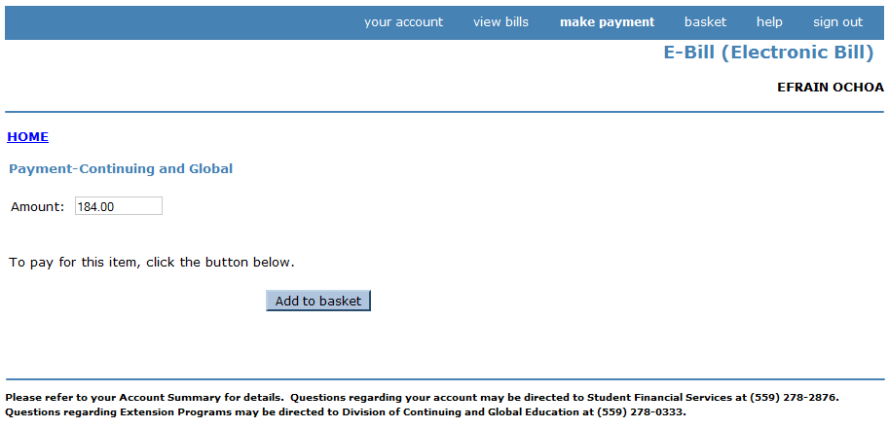
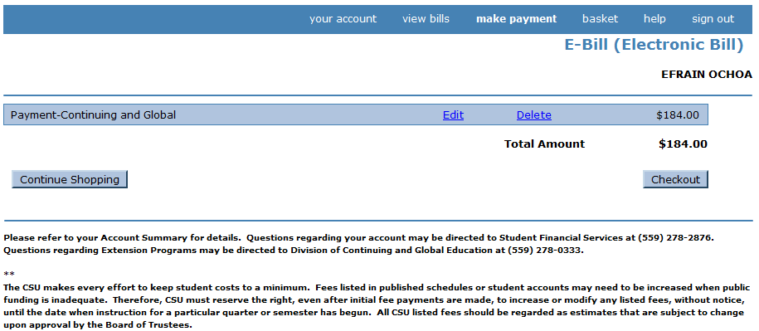
Checkout here
Amount to Pay
Fill in the amount you want to pay.

Slide 16
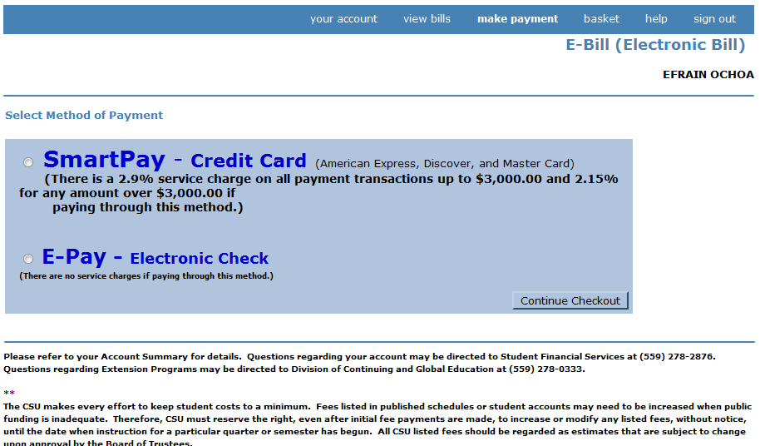
How are you paying?
Select a method of payment
Credit Card
Electronic Check

Slide 17
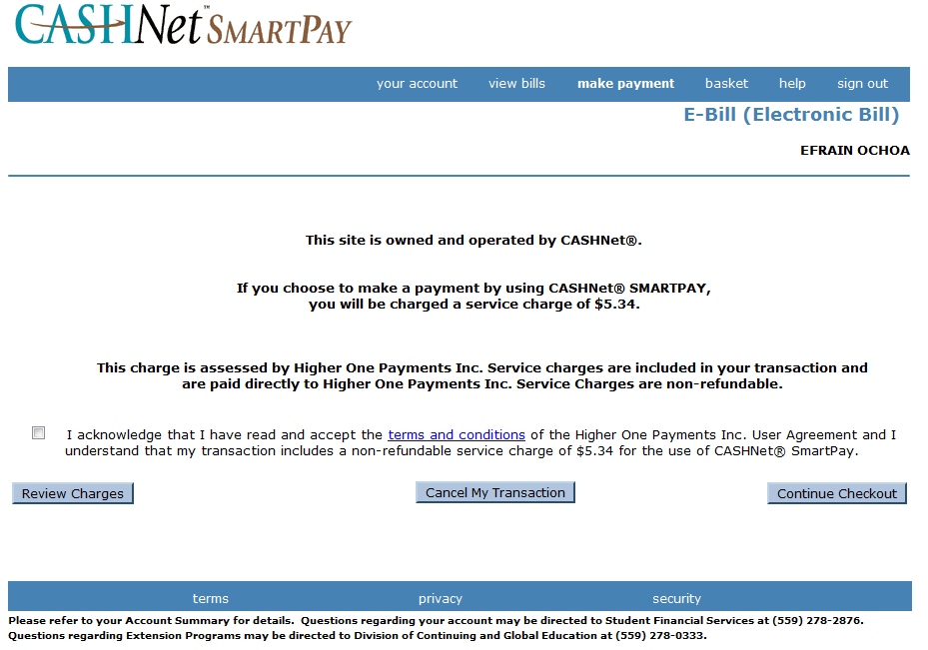
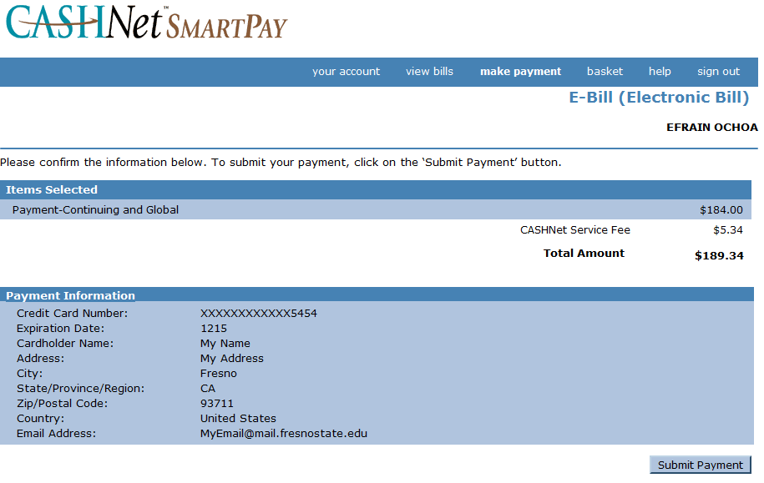
Paying by Credit Card


Slide 18
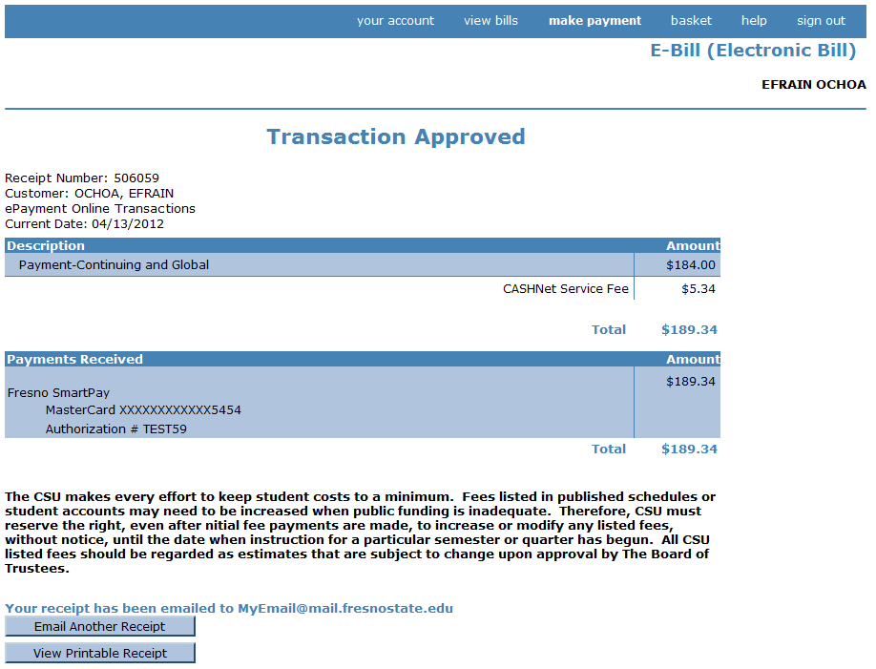
Paying by Credit Card
Print a receipt for your records.

Slide 19
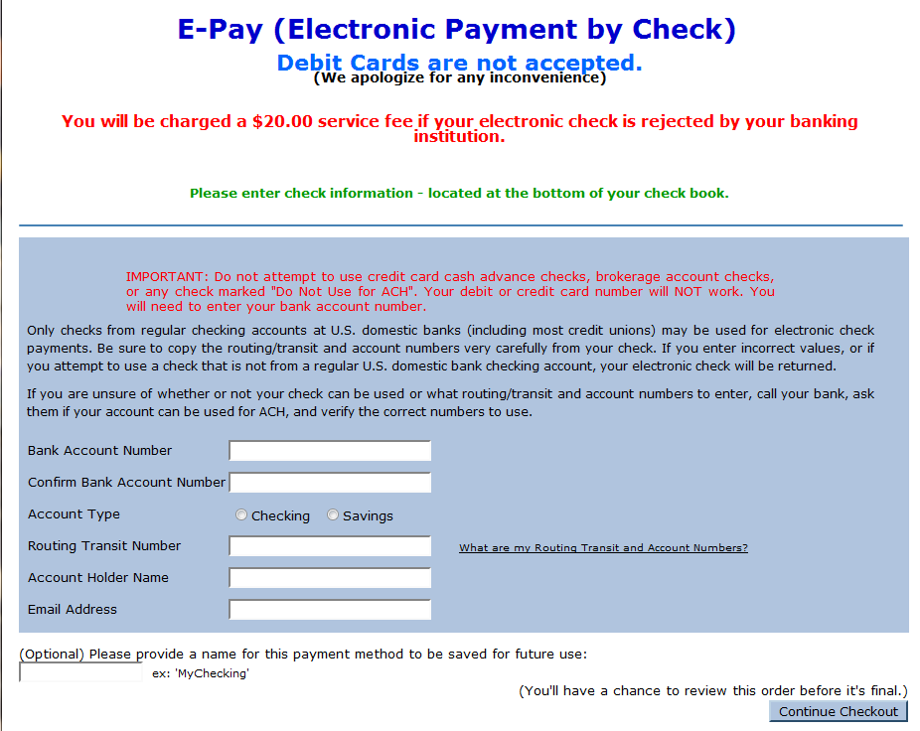
Paying with an Electronic Check
Fill in the required information and continue checkout

Slide 20
Early Start Program
Continuing & Global Education
559 – 278- 0333
www.csufresno.edu/cge
Need technical HELP registering or paying online.
Call the Student HELP desk at 278-7000
Monday – Friday
7 am – 9 pm
Saturday
8 am – 5 pm
Summer Hours
May 19 - August 8
Monday – Saturday
7 am – 6 pm
CGE:mlr 3/4/13

